Slide 1
Antarctica quiz
By: Derek, Melissa, Yzabelle
START HERE
Helpers

Slide 2
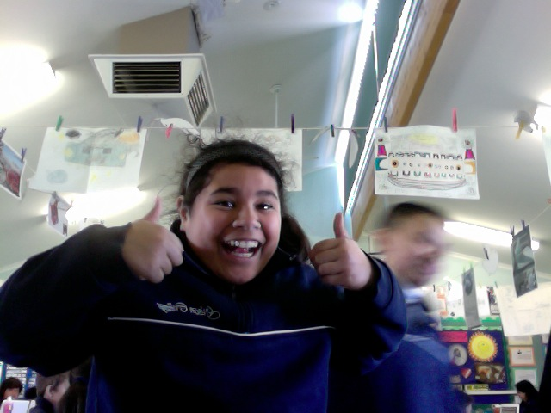
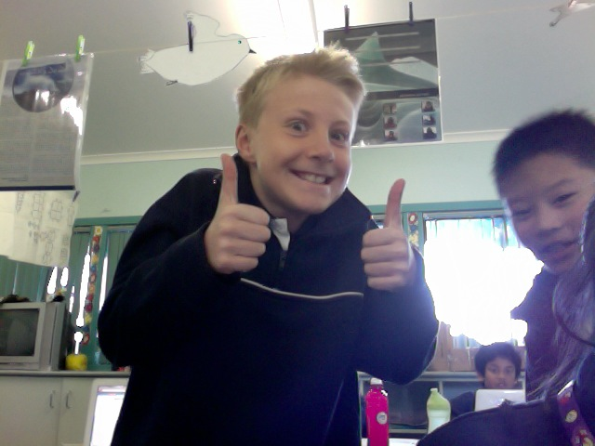
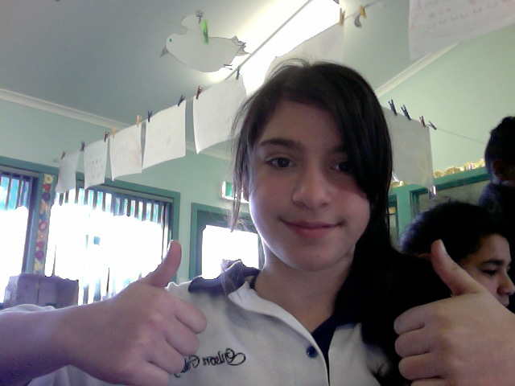
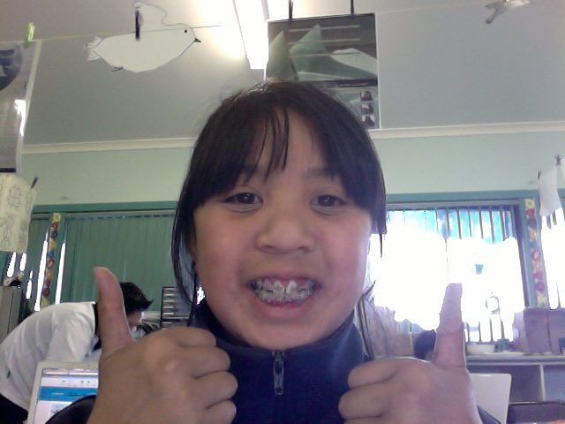
Olivia
Anthony and Derek
BACK<<
Melissa
Yzabelle

Slide 3
Which animal is a whale?
Chinstrap or Humpback

Slide 4
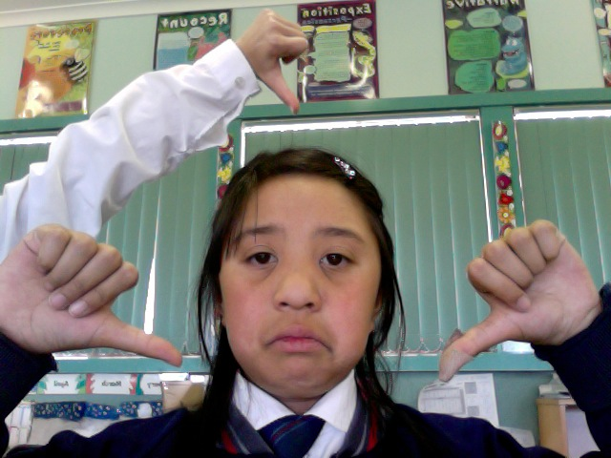
1st QUESTION WRONG
Next>>

Slide 5
How many different types of penguins are there in Antarctica?
5 Or 6

Slide 6
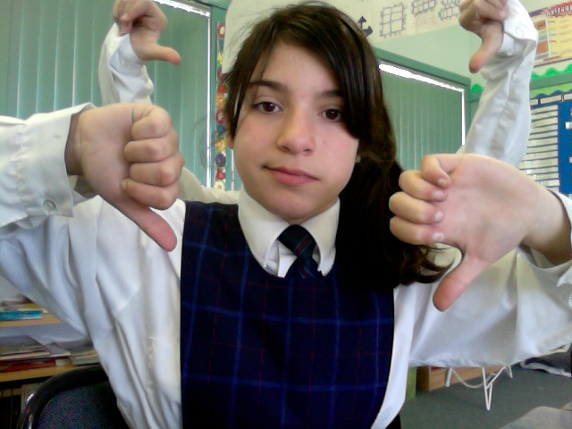
2nd QUESTION WRONG
Next>>

Slide 7
What happens when you throw warm water into the cold air?
It freezes immediately!
Or
It falls to the ground like normal water!

Slide 8
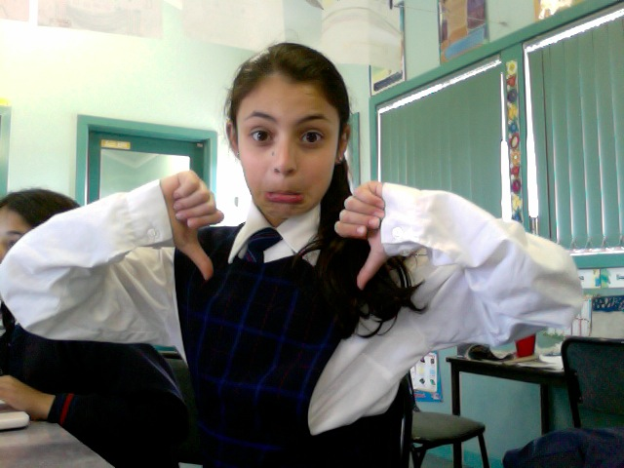
3rd QUESTION WRONG
Next>>

Slide 9
How many seals are there in Antarctica?
10 Or 7

Slide 10
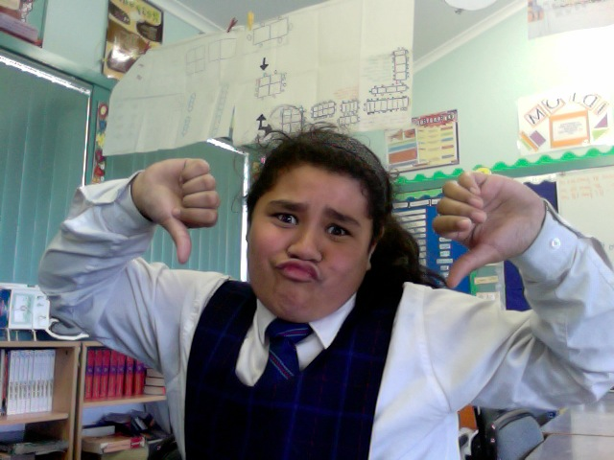
4th QUESTION WRONG
Next>>

Slide 11
Which seal was named after an Antarctica explorer?
Weddell or Ross

Slide 12
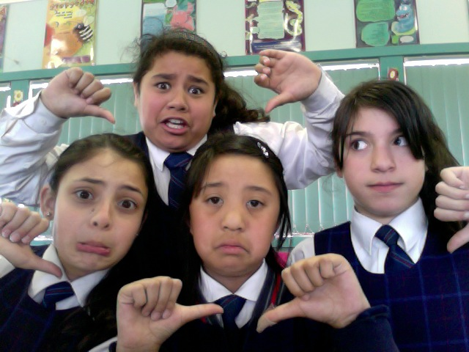
5th QUESTION WRONG
Next>>

Slide 13
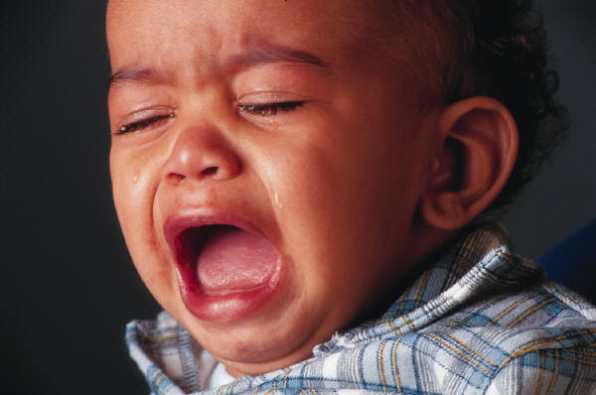
To bad to sad YOU LOSE!!!!!
Play again

Slide 14
YOU WON!!!!!!
Play again

